Slide 1
Hypothesis Testing

Slide 3
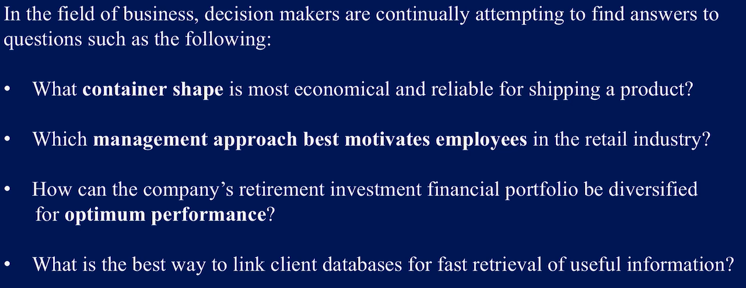
Applications

Slide 4
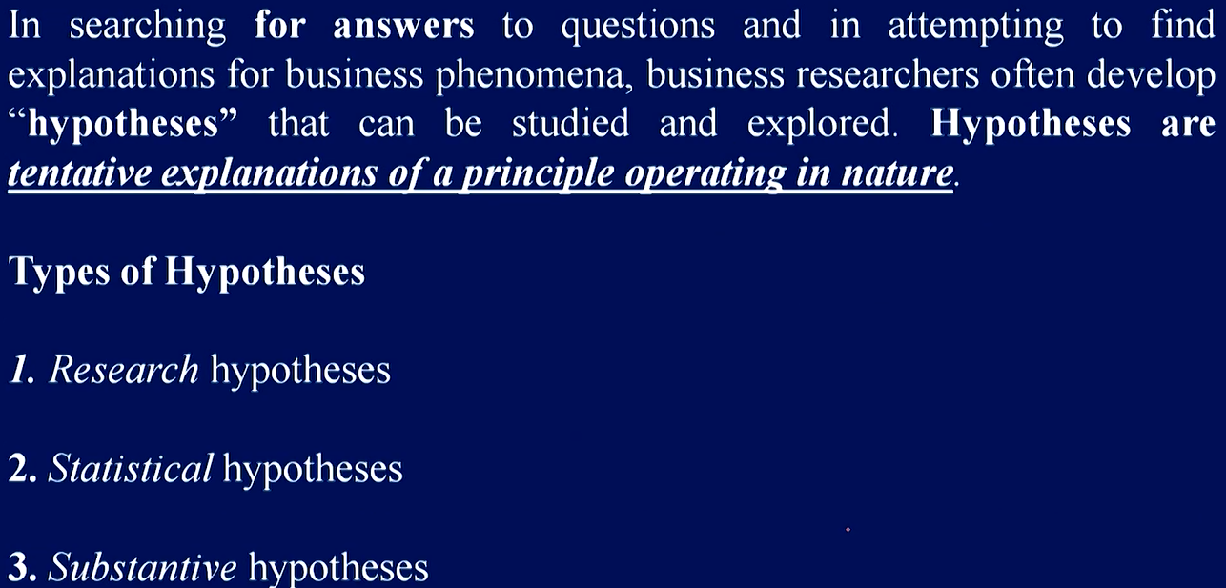
Cont’d…

Slide 5
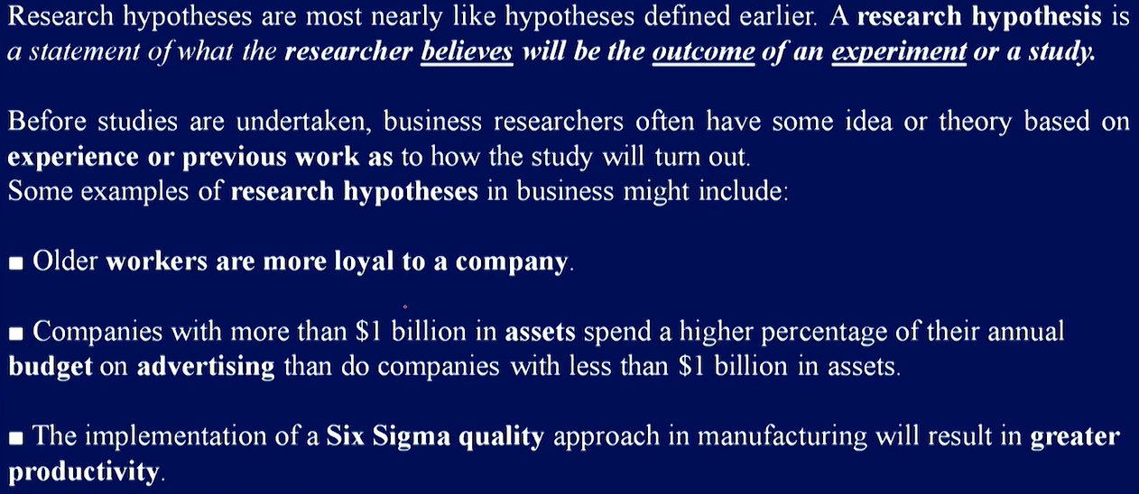
Research Hypotheses

Slide 6
Six Sigma
It is a process that makes use of statistics and data analysis to analyze and reduce errors or defects.
In this process, the purpose is to improve cycle times while reducing manufacturing defects to no more than 3.4 defects per million units or events.

Slide 7
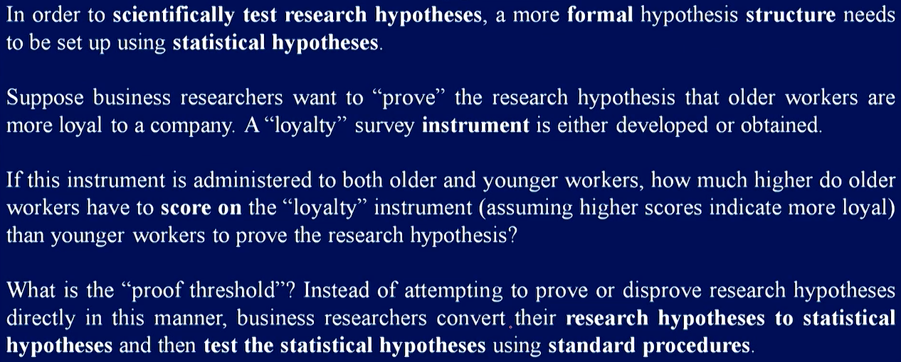
Statistical Hypotheses

Slide 8
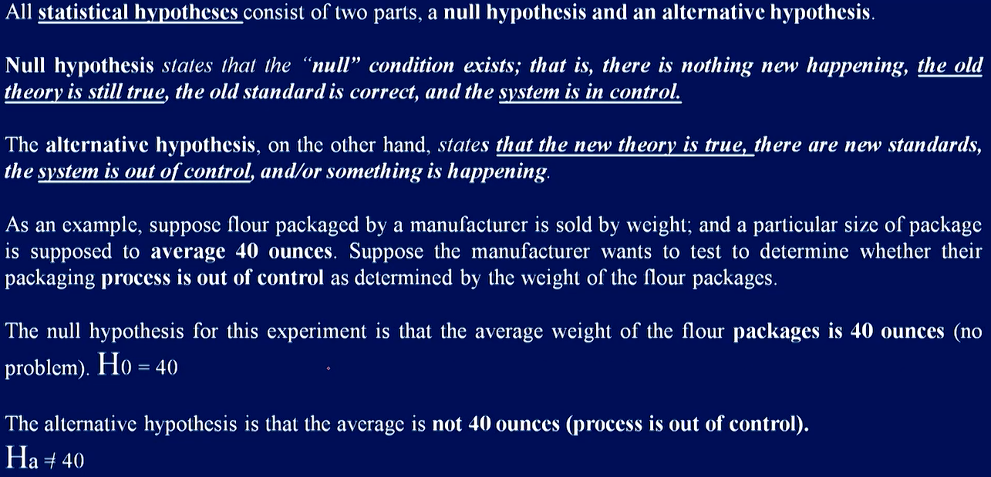
Cont’d…

Slide 9
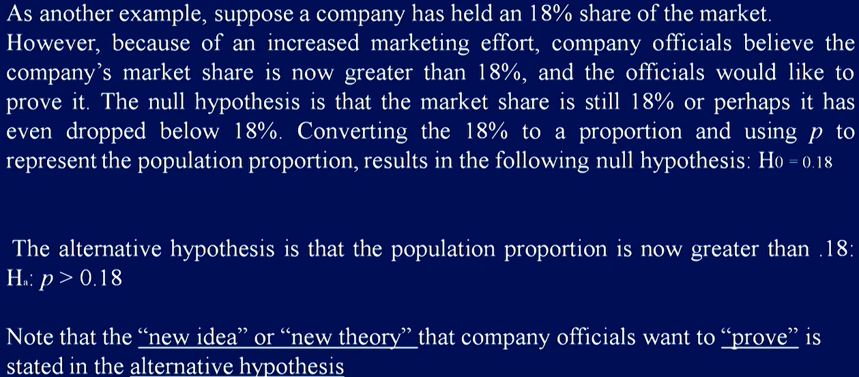
Example

Slide 10
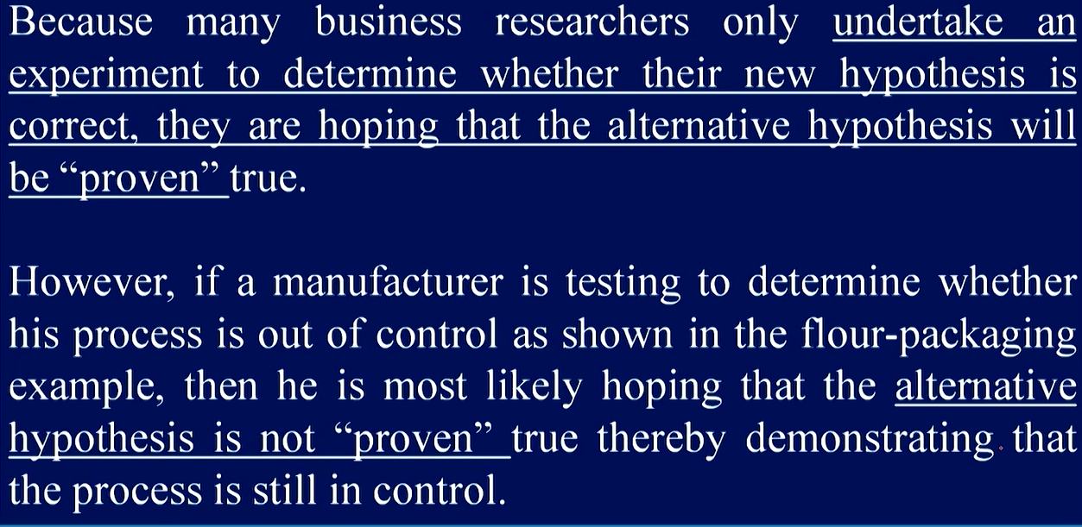
Cont’d…

Slide 11
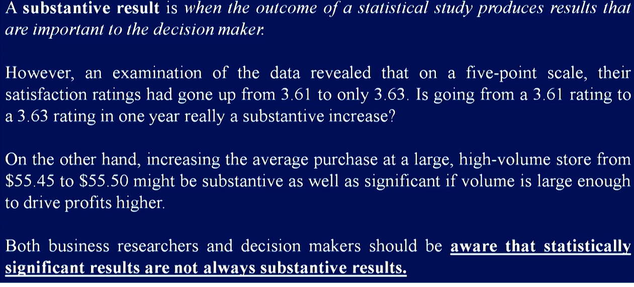
Substantive Hypotheses

Slide 12
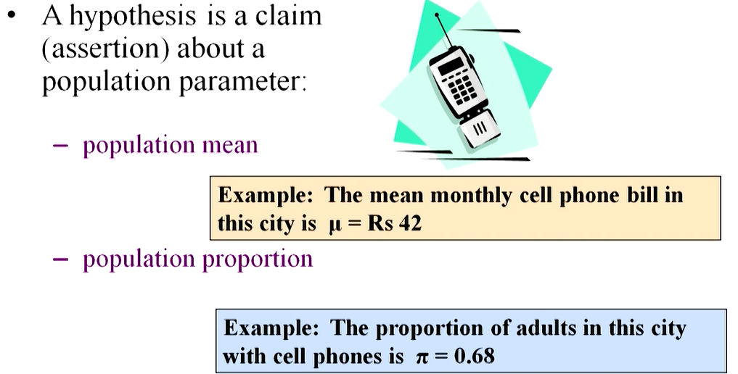
What is a Hypothesis?

Slide 13

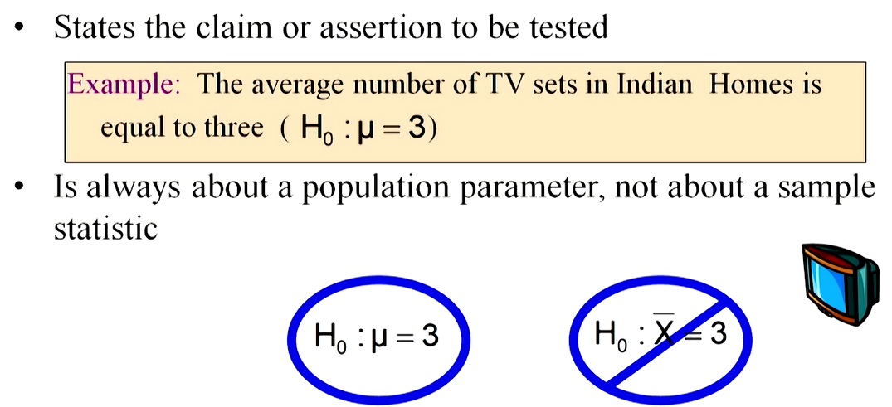
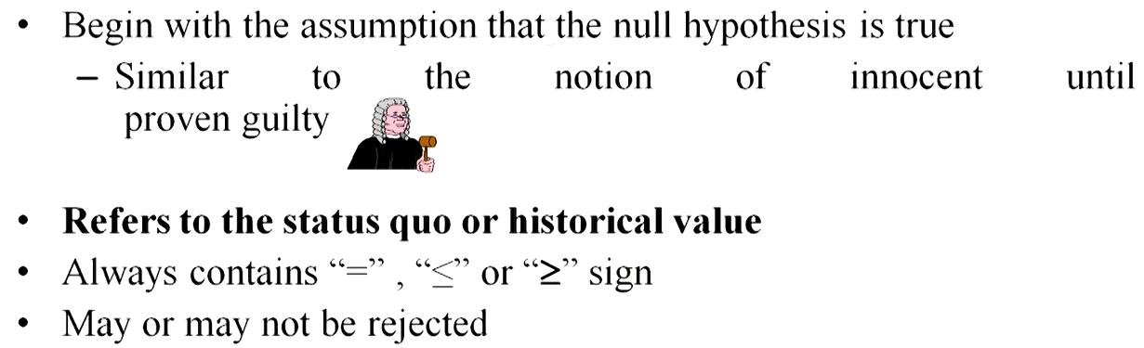

Slide 14
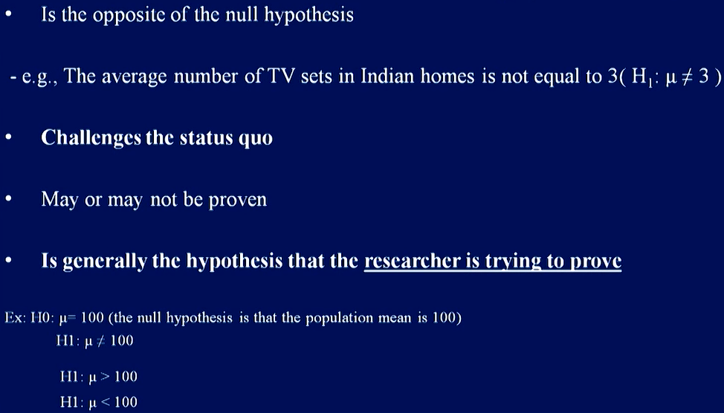

Slide 15
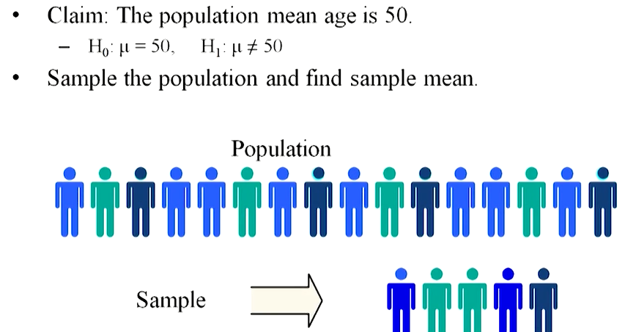

Slide 16
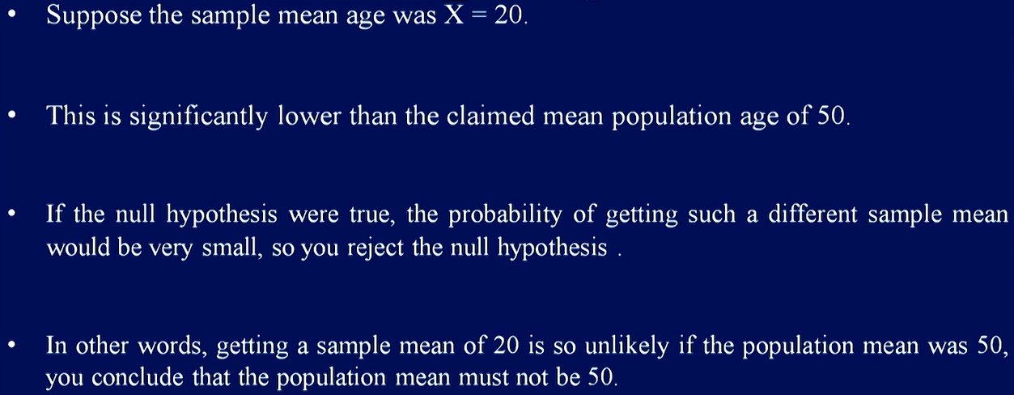
Cont’d…

Slide 17
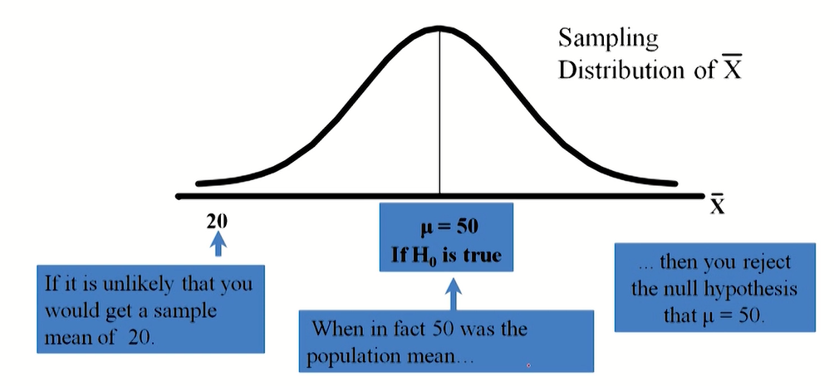
Cont’d…

Slide 18
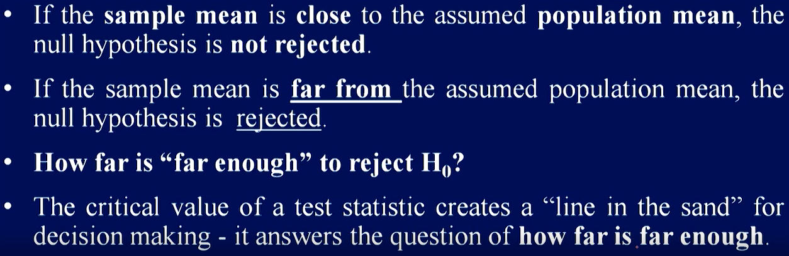
The Test Statistics and Critical Value

Slide 19
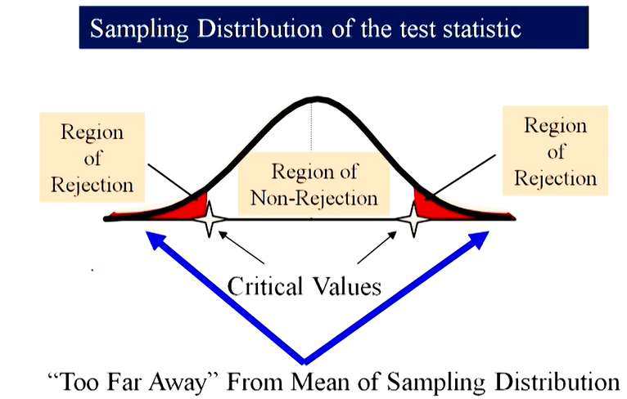
Cont’d…

Slide 20
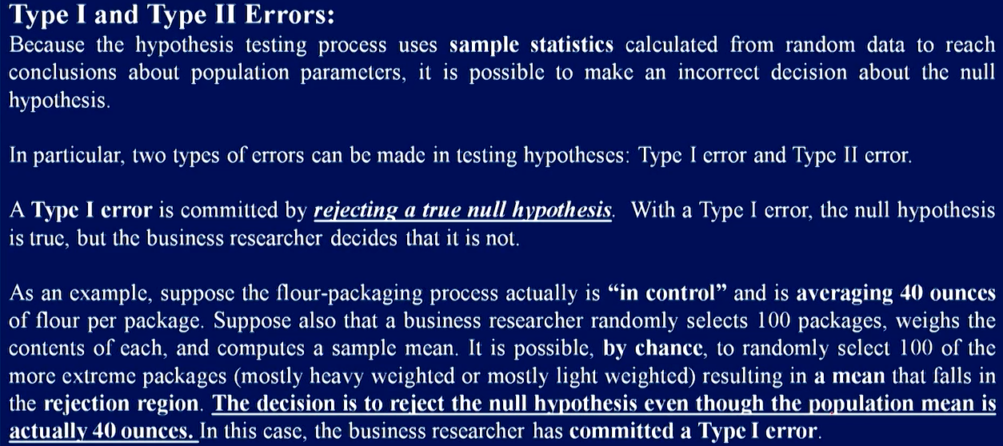
Possible Errors in Hypothesis Testing

Slide 21
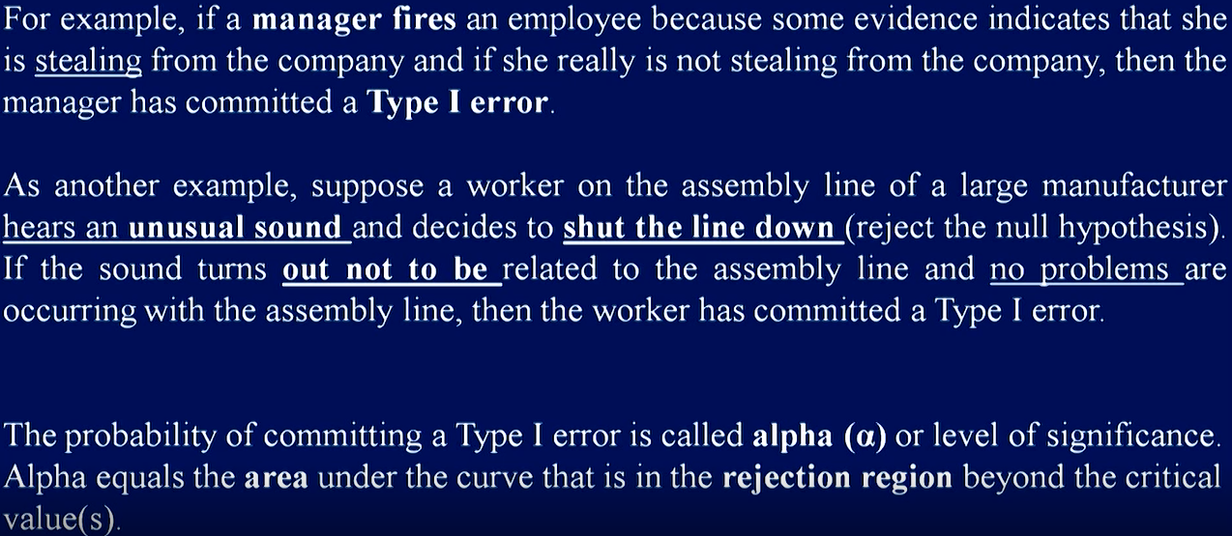
Cont’d…

Slide 22
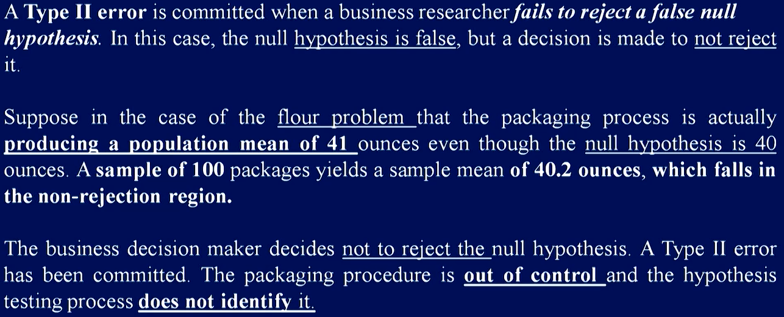
Cont’d…

Slide 23
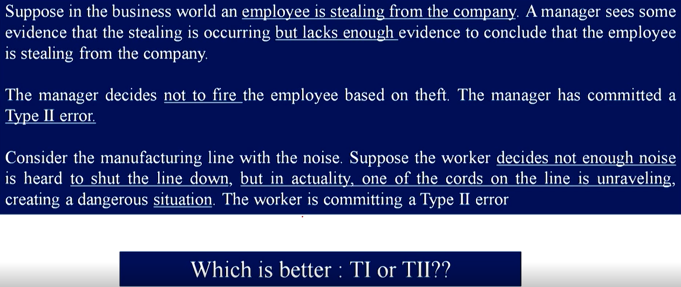
Cont’d…

Slide 24
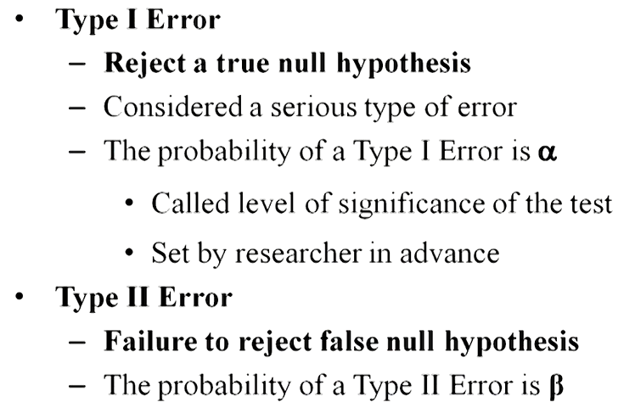
Cont’d…
The Type-I (false-positive) error is worse than a Type-II (false-negative) error
If you stick to the status quo or default assumption, at least you’re not making things worse.

Slide 25
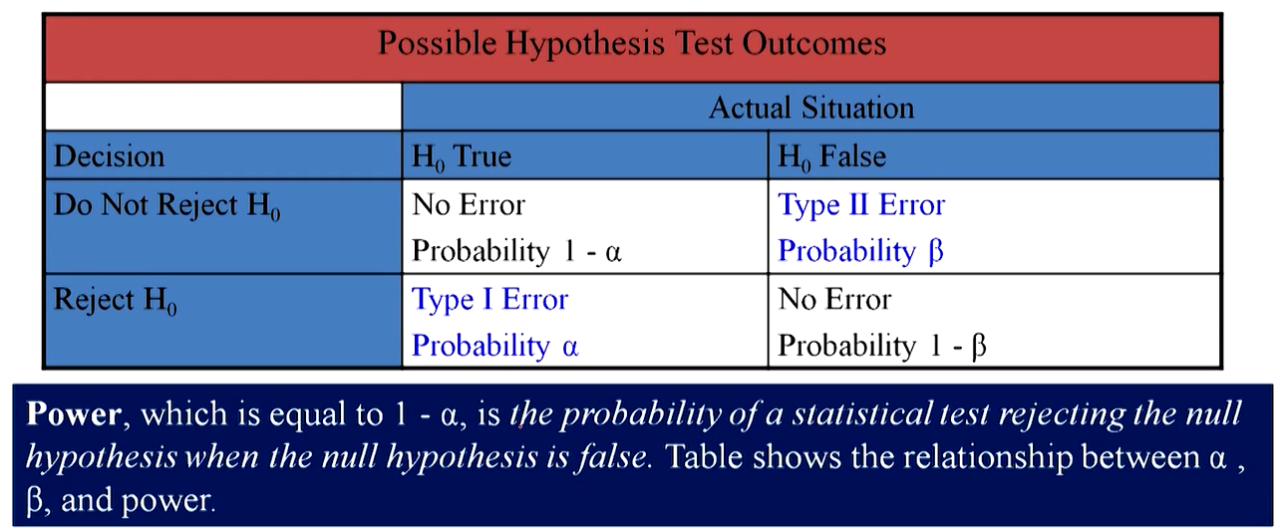
Possible Errors in Hypothesis Test Decision Making

Slide 26
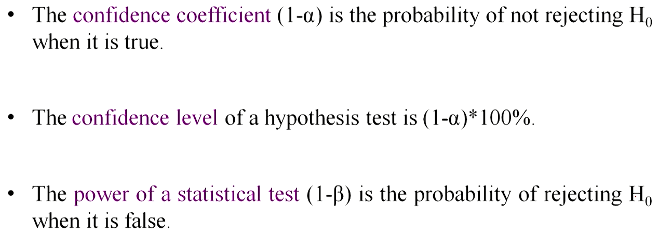
Cont’d…

Slide 27
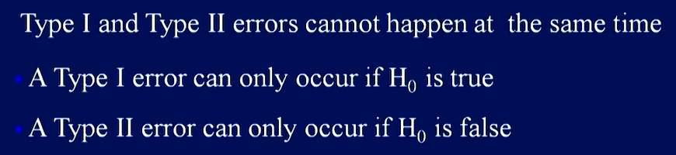
Type I and II Relationship

Slide 28
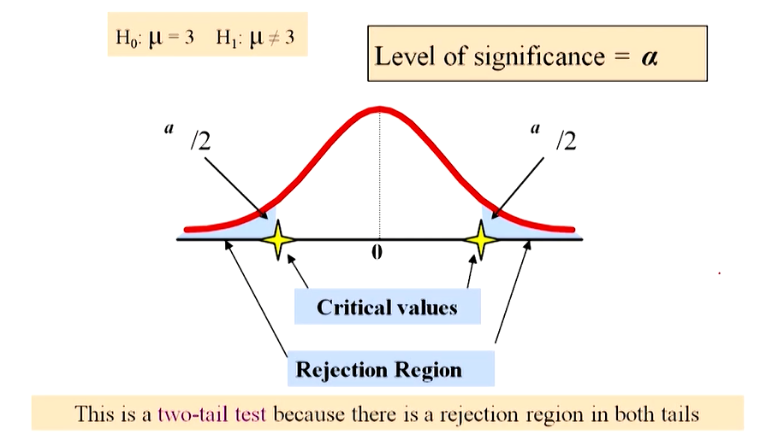
Level of Significance and Rejection Region

Slide 29
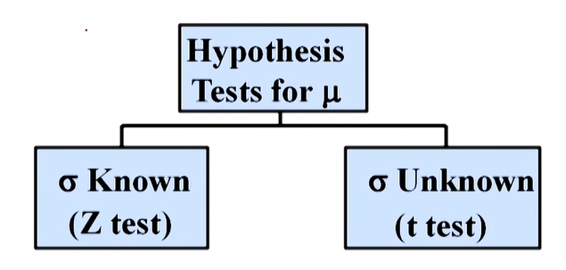
Hypothesis Tests for the Mean

Slide 30
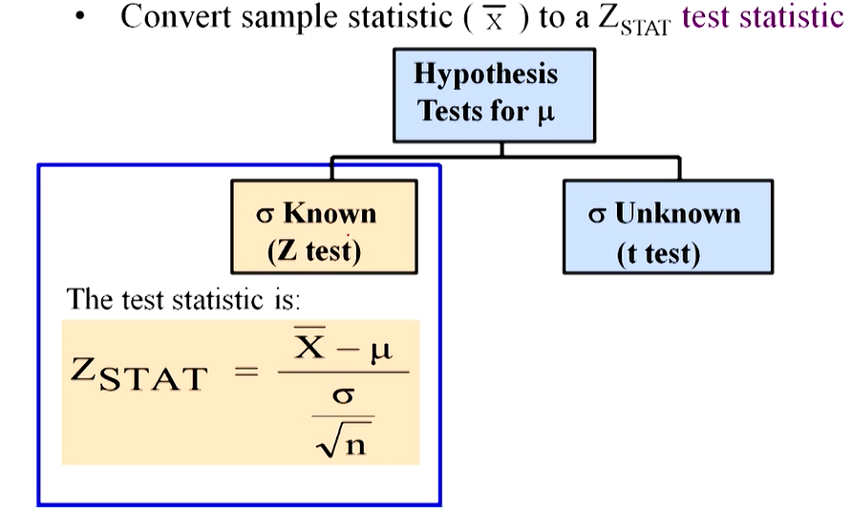

Slide 31
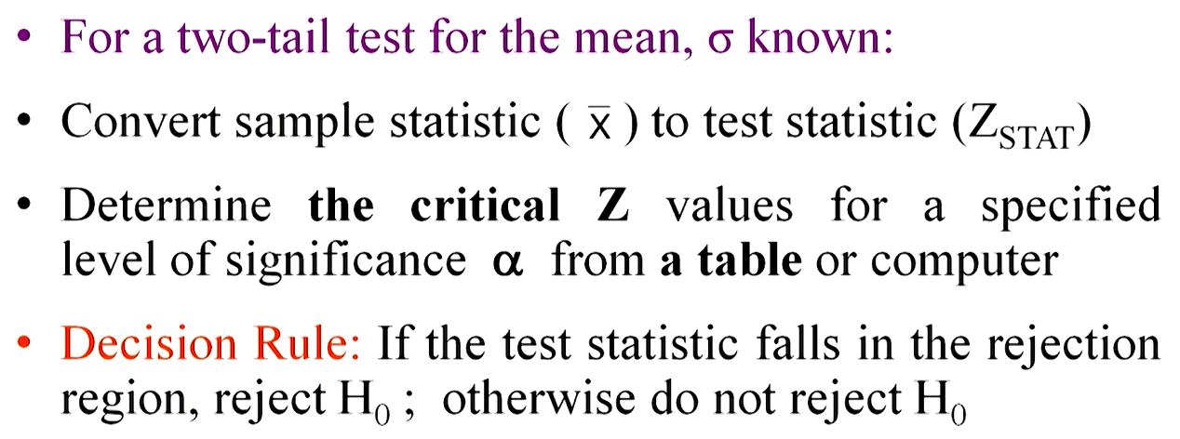
Critical value Approach to Testing

Slide 32
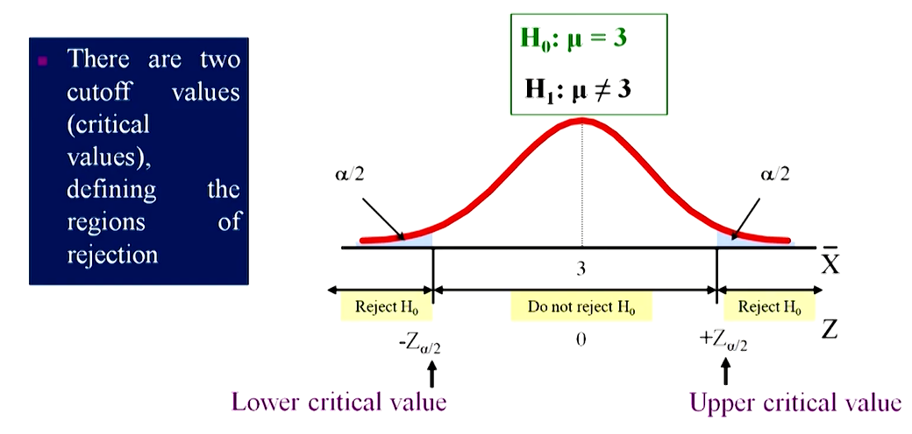
Two-Tail Tests

Slide 33
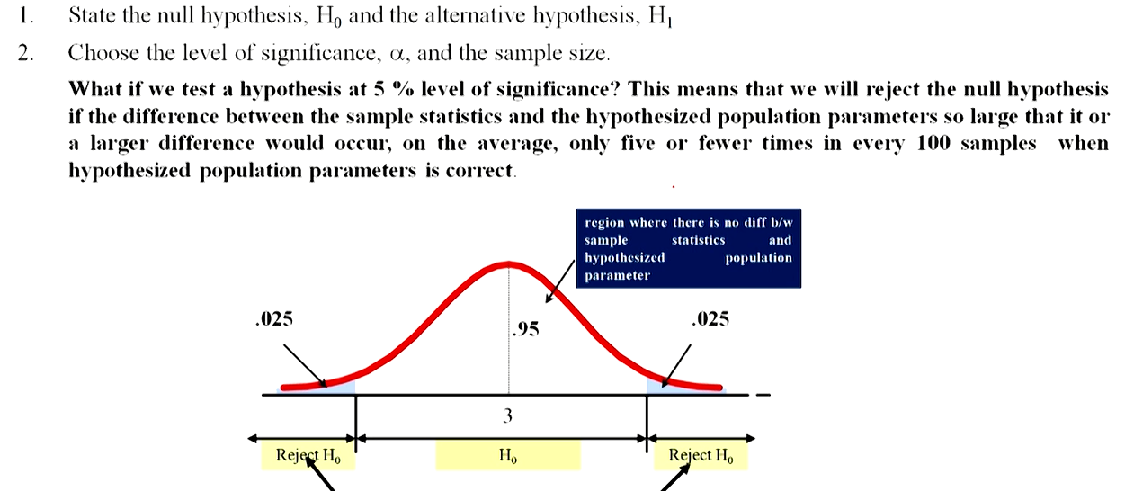
Steps in Hypothesis Testing

Slide 34
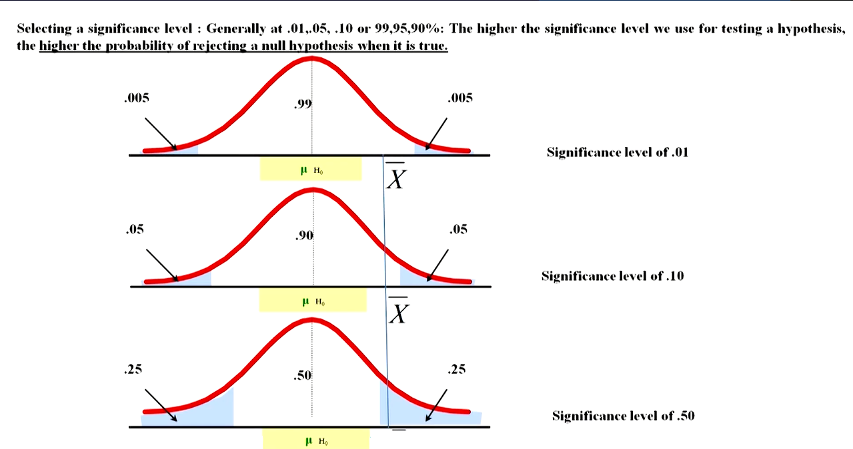
Cont’d…

Slide 35
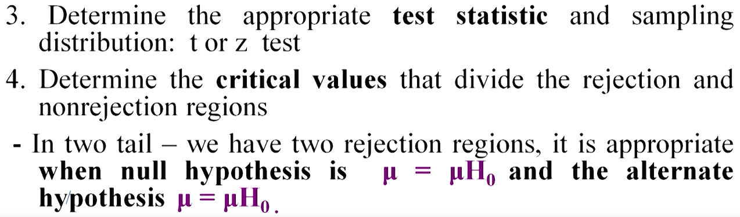
Cont’d…

Slide 36
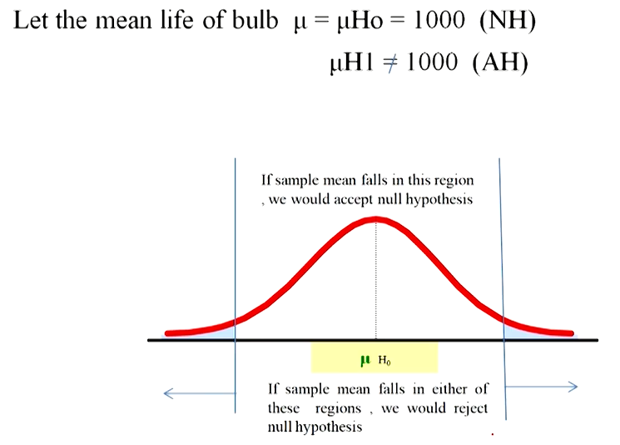
Cont’d…

Slide 37
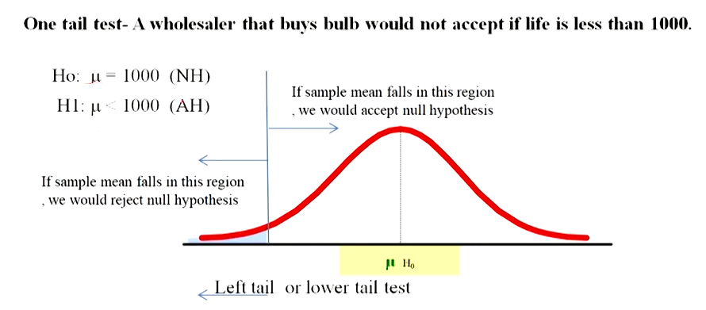
Cont’d…

Slide 38
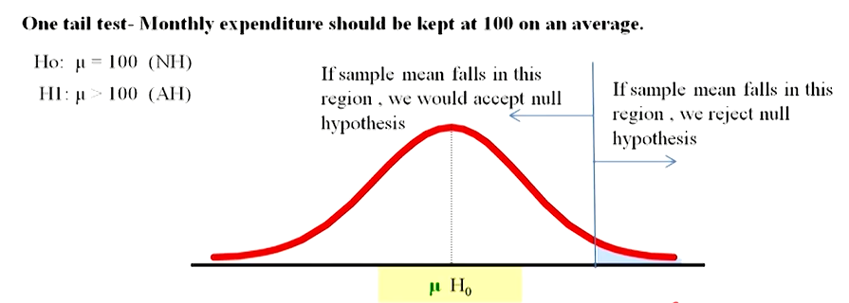
Cont’d…

Slide 39
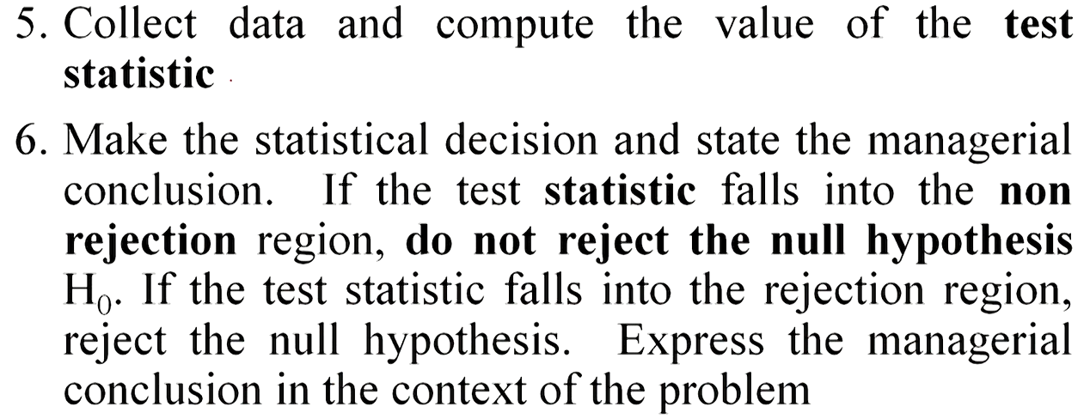
Cont’d…

Slide 40
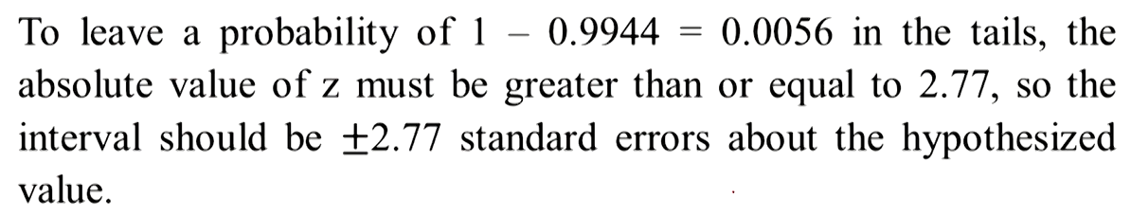
Example

Slide 41
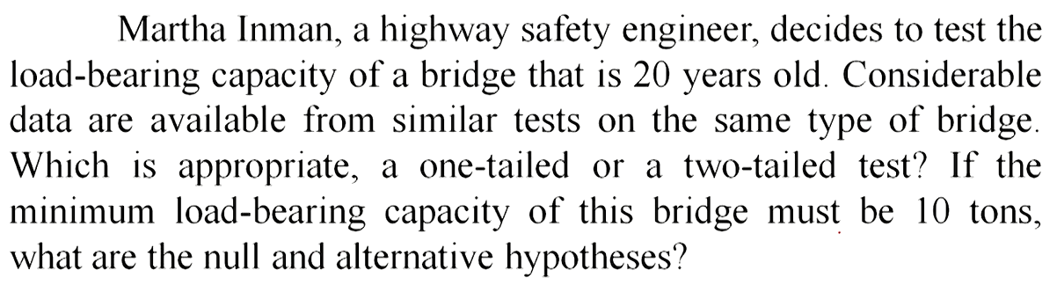
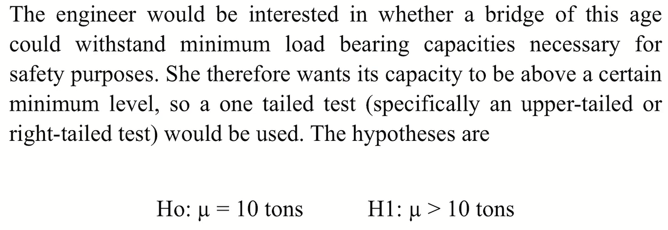
Example

Slide 42
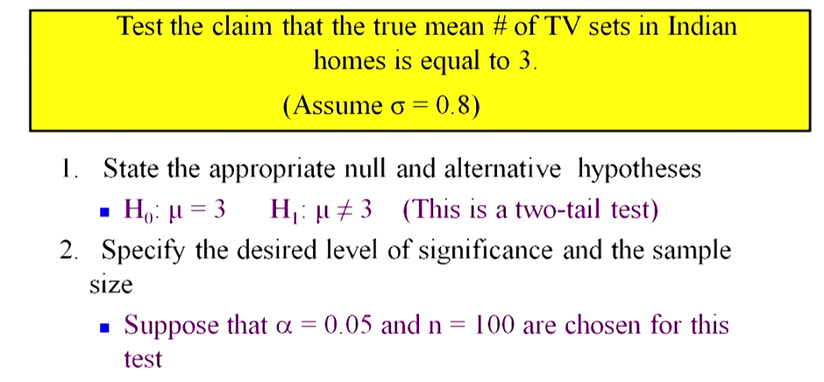
Example

Slide 43
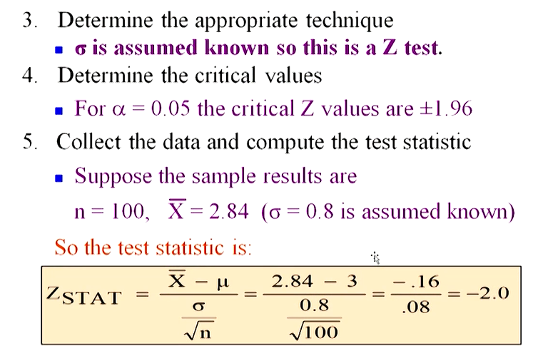
Cont’d…

Slide 44
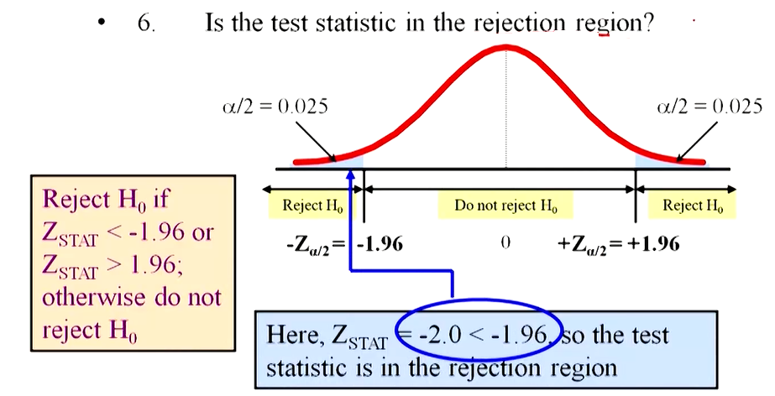
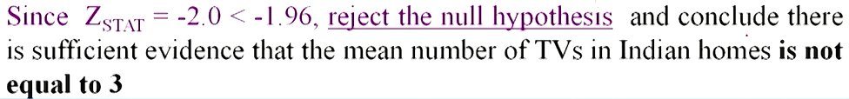
Cont’d…

Slide 45
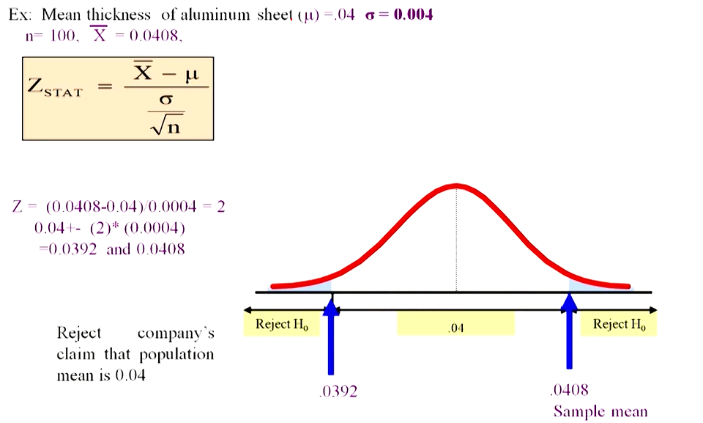
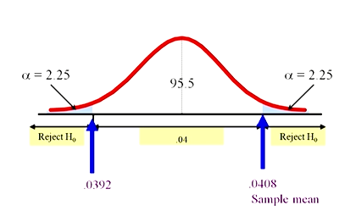
Example

Slide 46
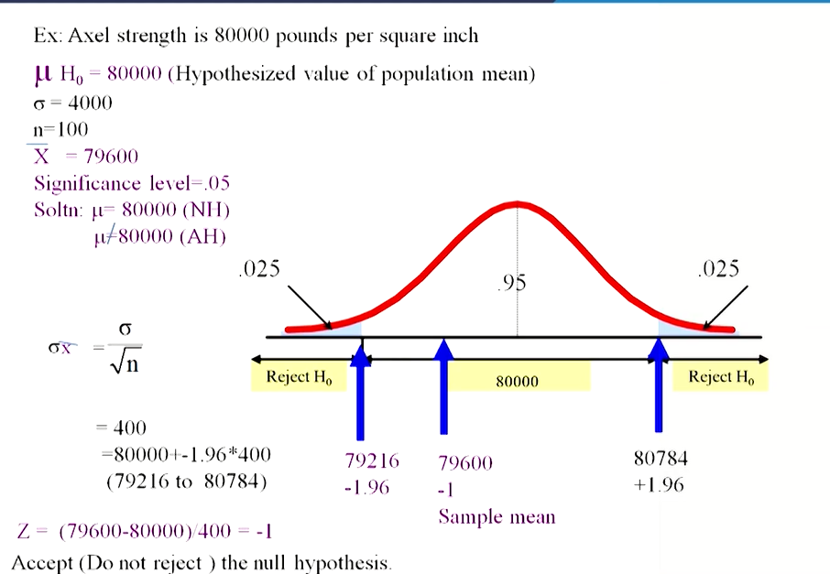
Example

Slide 47
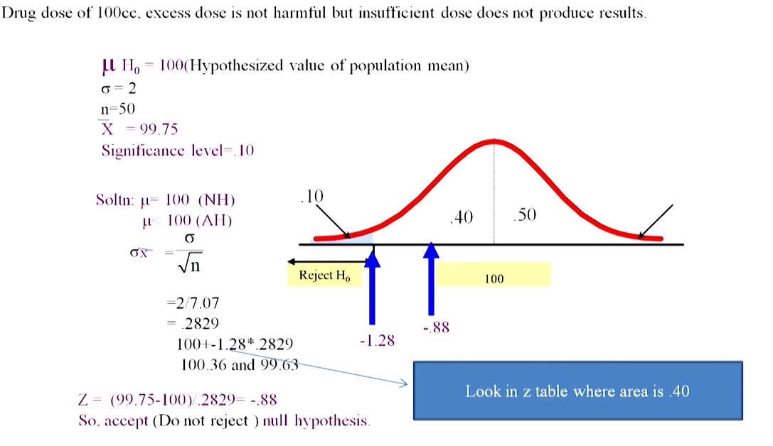
Example

Slide 48
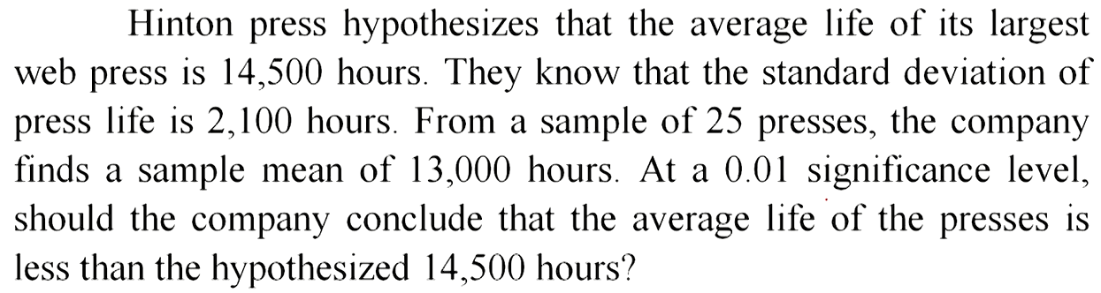
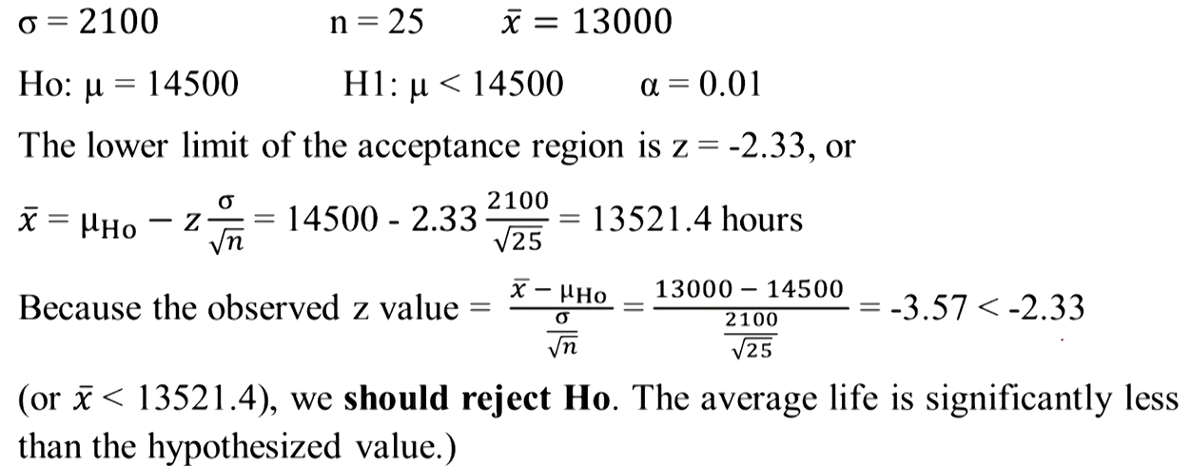
Example

Slide 49


p-value Approach to Testing

Slide 50

Cont’d…

Slide 51

Example

Slide 52

Cont’d…

Slide 53


Slide 54

Cont’d…

Slide 55

Cont’d…

Slide 56

Connection Between Two Tail Test and Confidence Intervals

Slide 57


Slide 58


Slide 59


Slide 60




Slide 61

Cont’d…

Slide 62


